Slide 1
The Food Coach
Angular Project

Slide 2
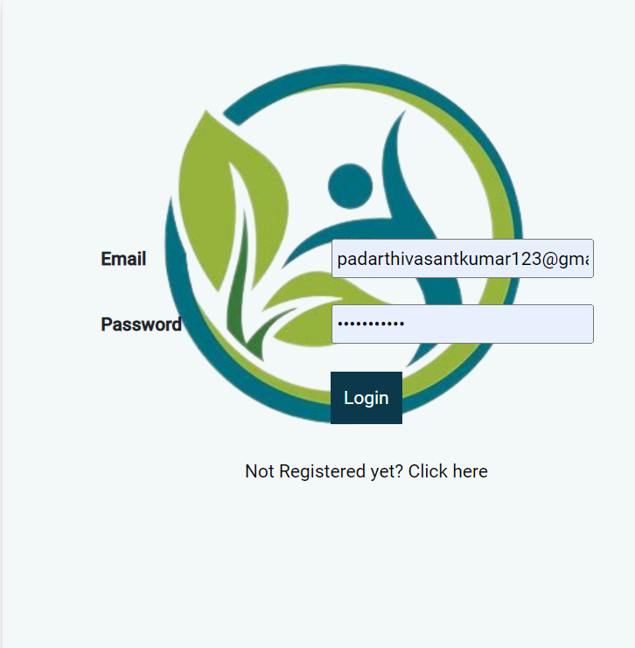
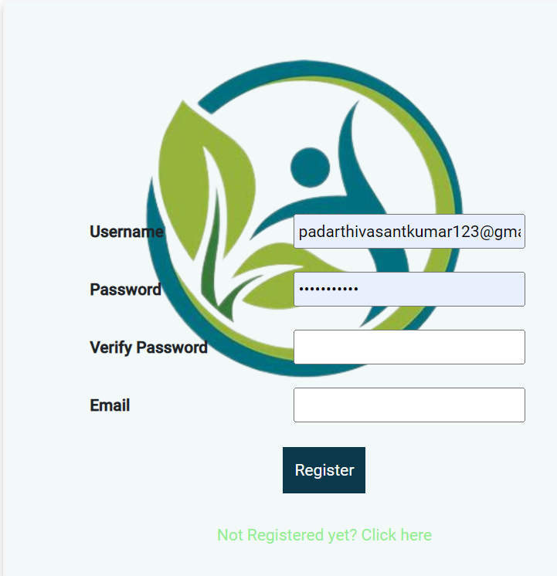
Login Component :
-User Login
-Admin Login
-Registration

Slide 3
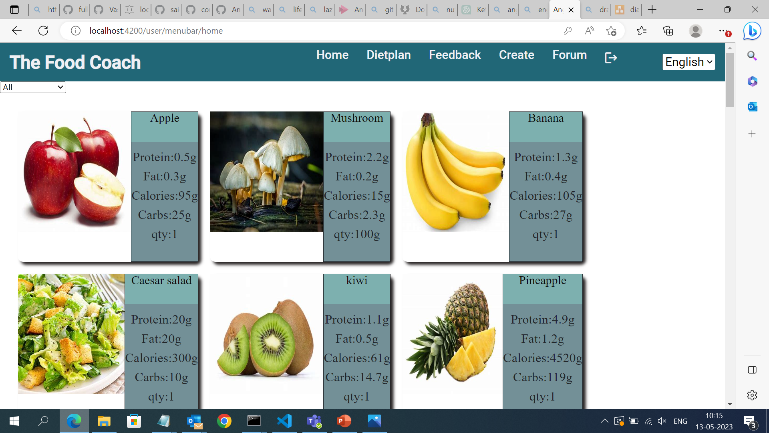
User-Home:
-It consists of the products that is available. Different types of products such as Fruits,Vegetables,Salads,Milk-Products,Juices.
-It also shows the Protein%,Fat%,Calories,Carbs% present in each product within the home page.
-The type filter is inserted for selecting the particular type of product.

Slide 4
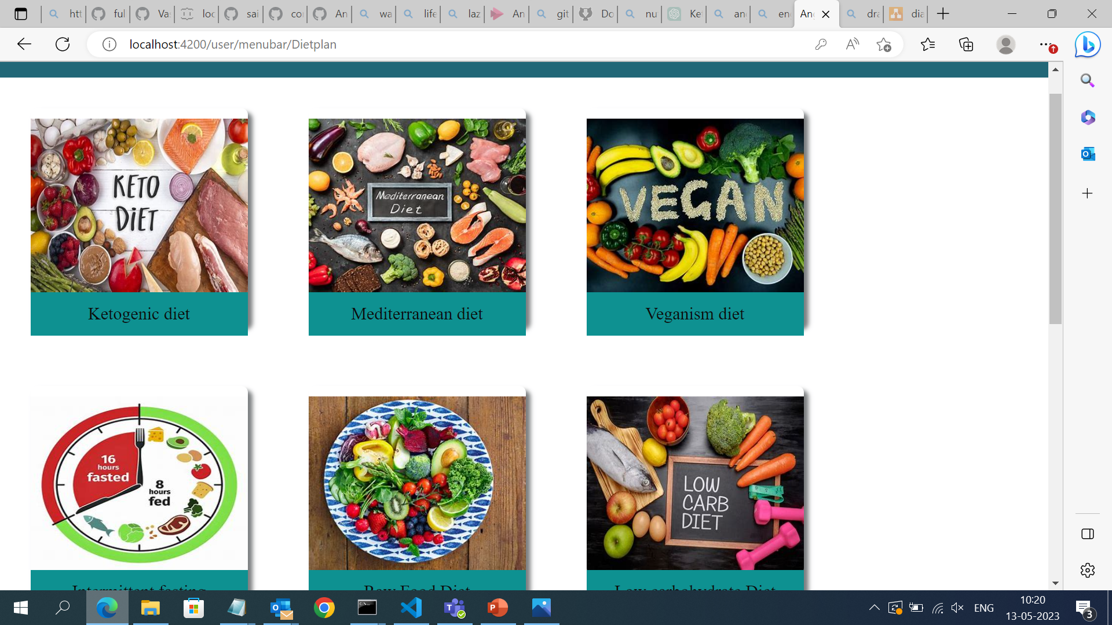
User-Diet-Plan:
-This is the component where we can select the type of diet as our wish.
-If we click on the diet-plan it shows the diet-plan such as Break-fast, Lunch, Dinner according to the diet-plan.

Slide 5
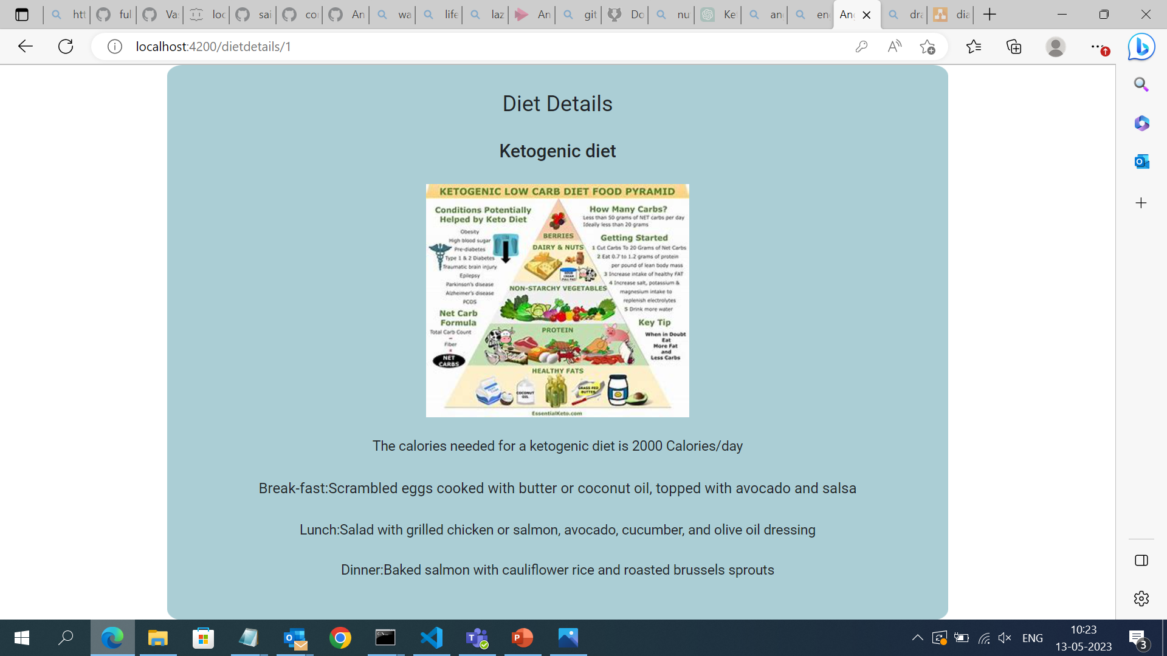
User-Diet-Details:
-If we click on the Diet-Type it routes to the details of that particular diet-type.

Slide 6
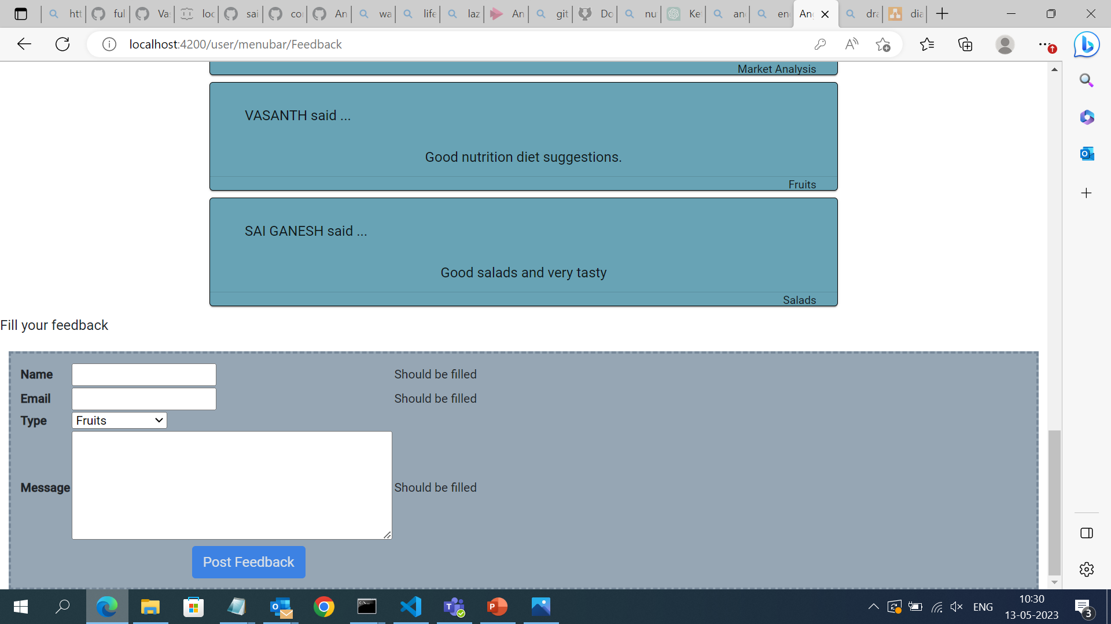
User-Feedback
-This is the feedback component that the customer can fill accordingly.
-The feedbacks that filled by customers can be displayed above the feedback-form.

Slide 7
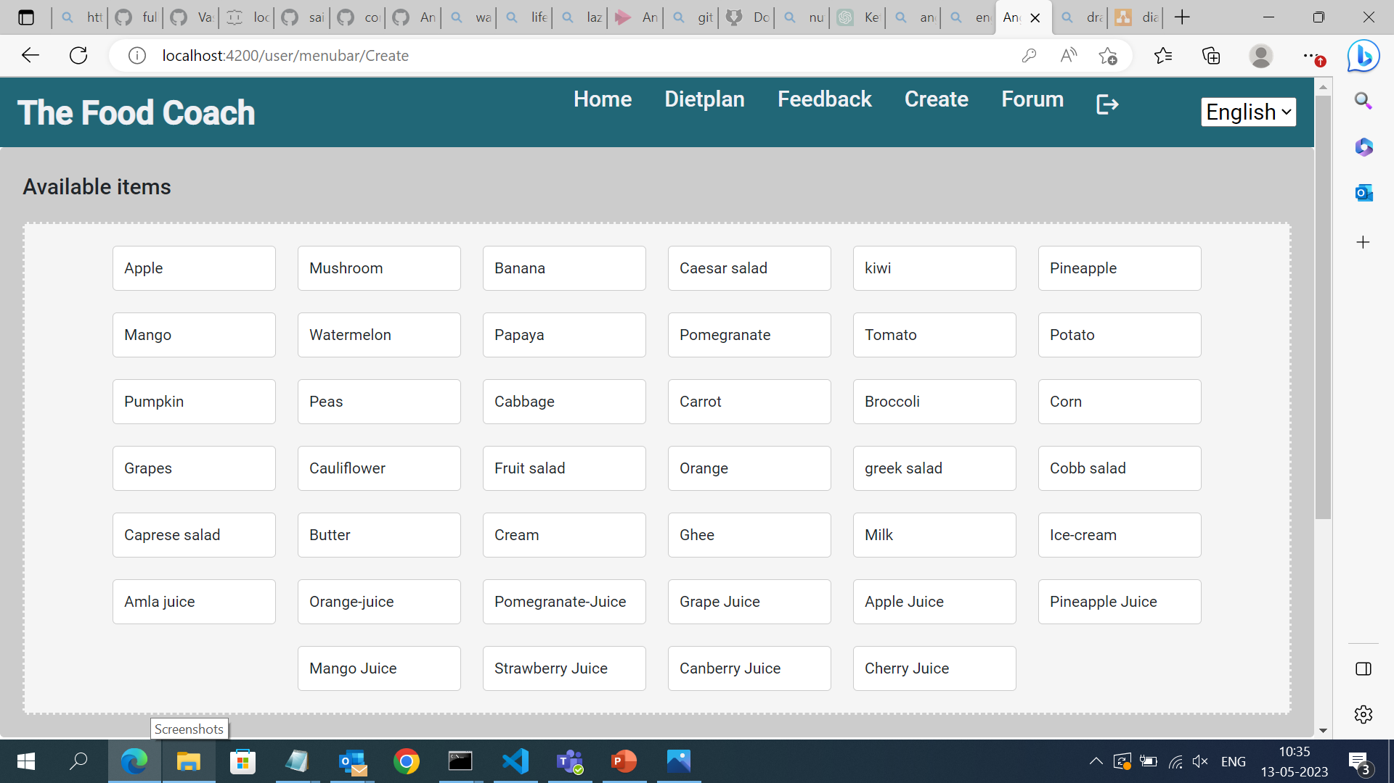
User-Create:
-The create component which makes the users to create their own diet according to the products available.
-We can use drag and drop method to create our own diet.
-It can also calculates the nutrition values present in it and it can be displayed.
-Displaying the available-items:

Slide 8
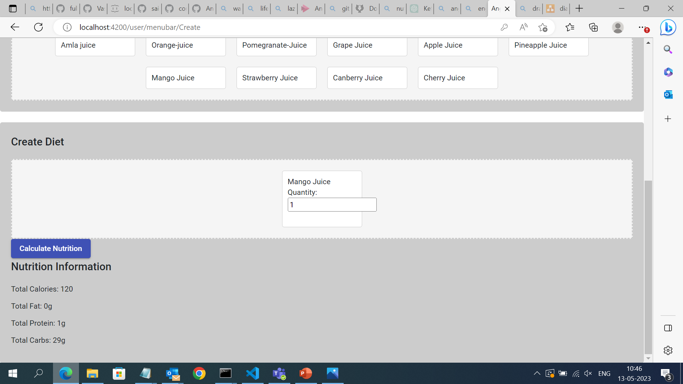
-By using Drag and Drop method we can create our own diet.
-It can calculate the nutrition values for our dragged items and it should be displayed.

Slide 9
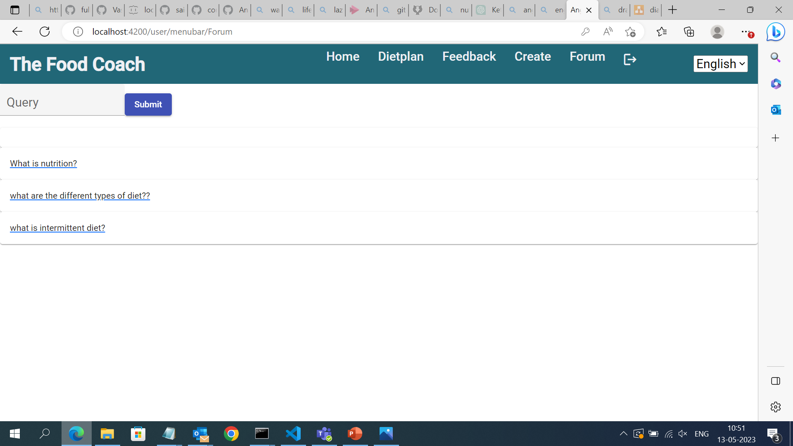
User-Forum:
-This is the component where the user can ask the queries to the admin regarding to the website.
-So that the admin can answer to the queries from the admin side and the user can see the answer given by the admin.

Slide 10
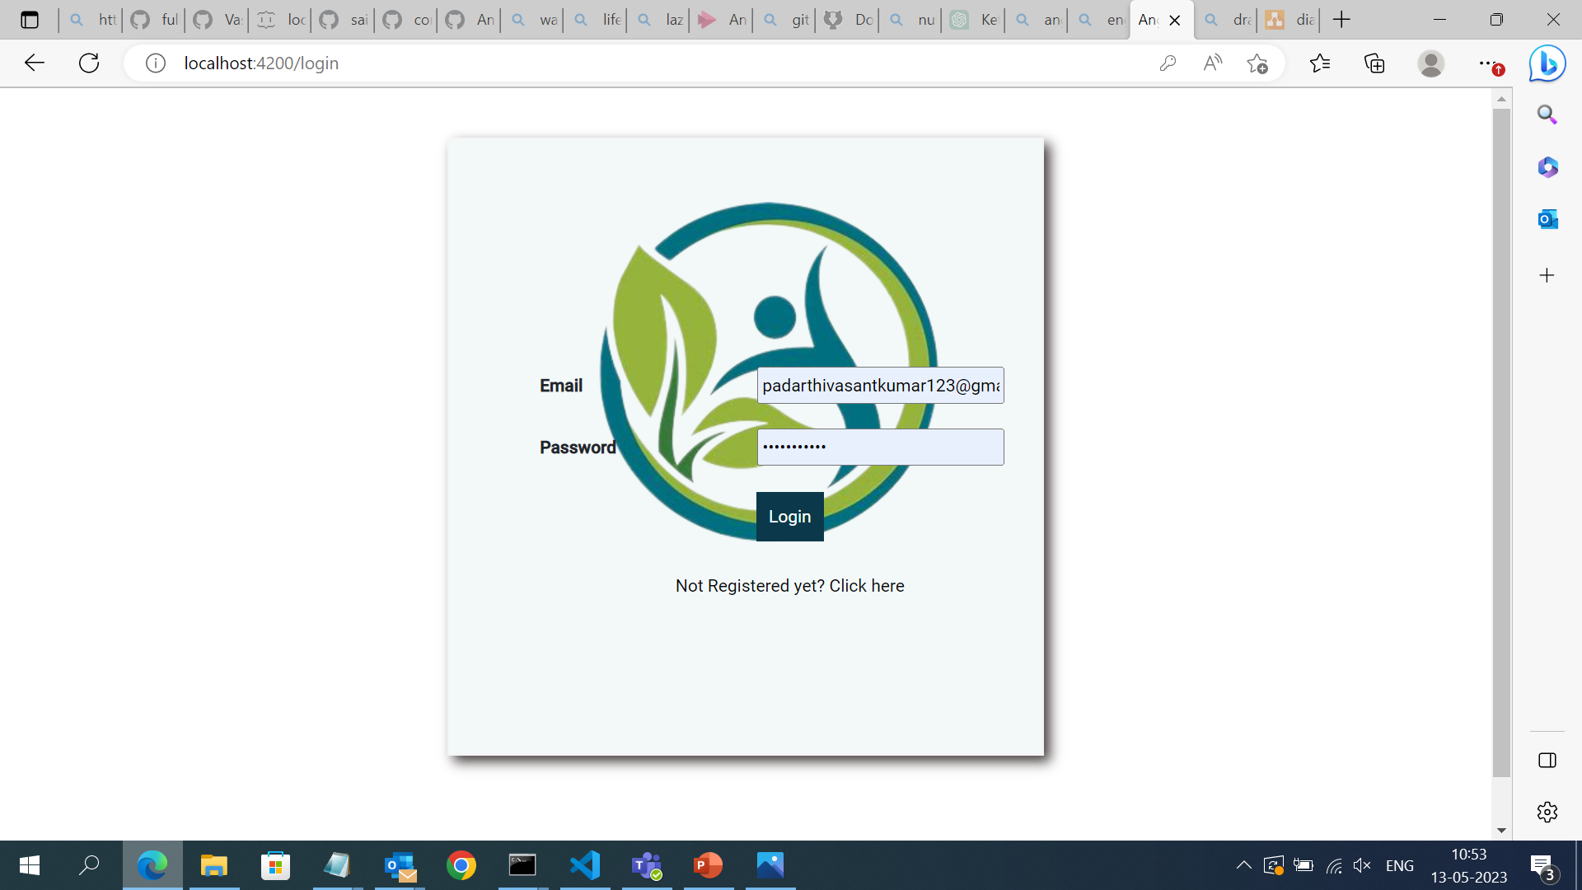
User-Logout:
-The user can logout and it should be redirected to the login page.

Slide 11
Admin-Home:
-It shows the products in the form of list that available.
-It also shows the nutrition values present in it.

Slide 12
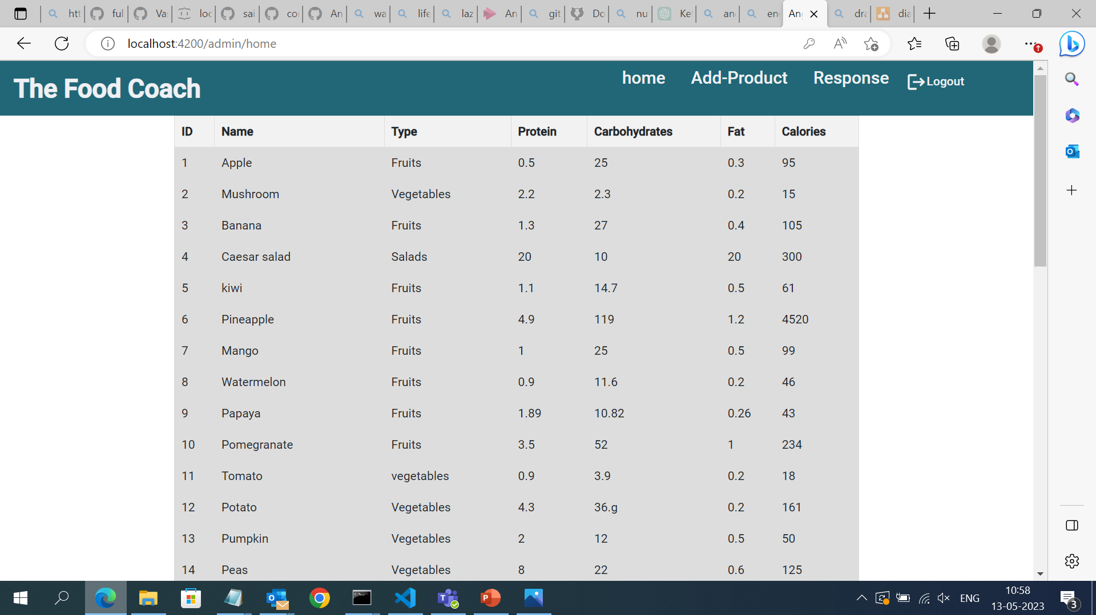
Admin-Home:

Slide 13
Admin-Add Product:
-This component makes the admin to add the product by entering name,Image,Nutrition values present in it.
-The added product will be shown in list of products that user can saw.

Slide 14
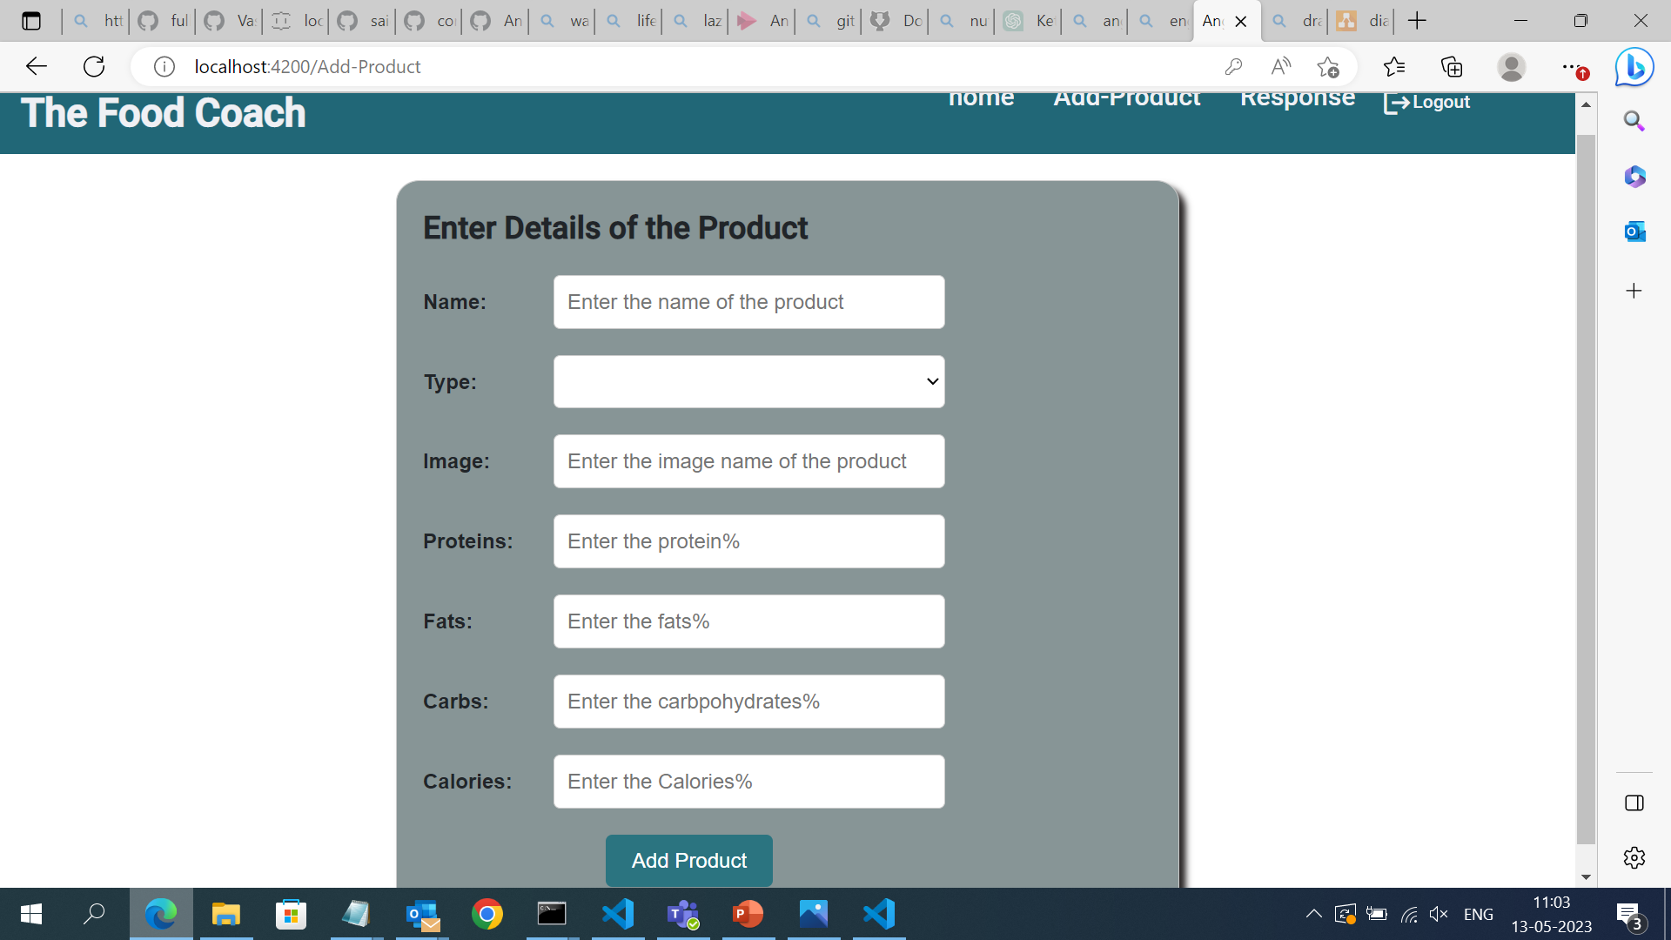

Slide 15
Admin-Response:
-This component can be used by the Admin to respond to the question that is asked from the user.
-This answer can be able to see by the user if they click on that particular question.

Slide 16
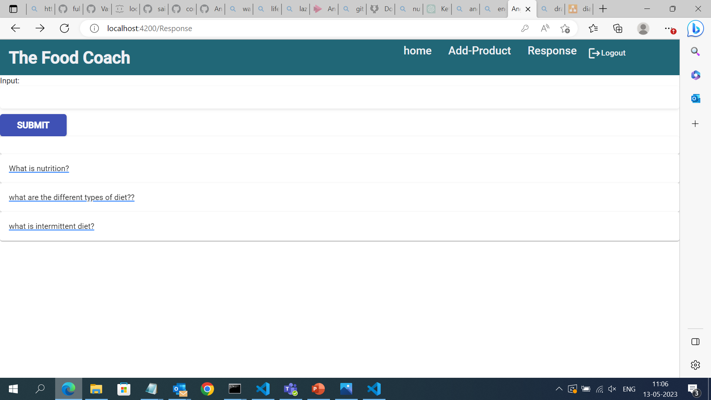

Slide 17
Admin-Logout:
-The admin can logout and it can be redirects to the login page.

